Slide 1
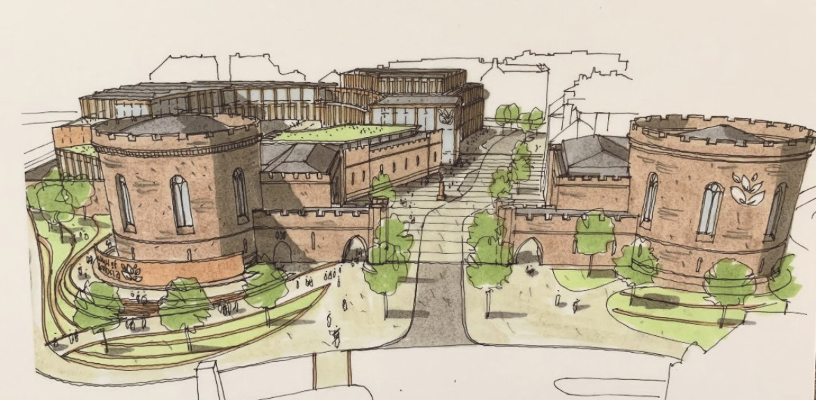
Returning to SocMedHE’s why, to think about SocMedHE’s future what and how’s

Slide 2
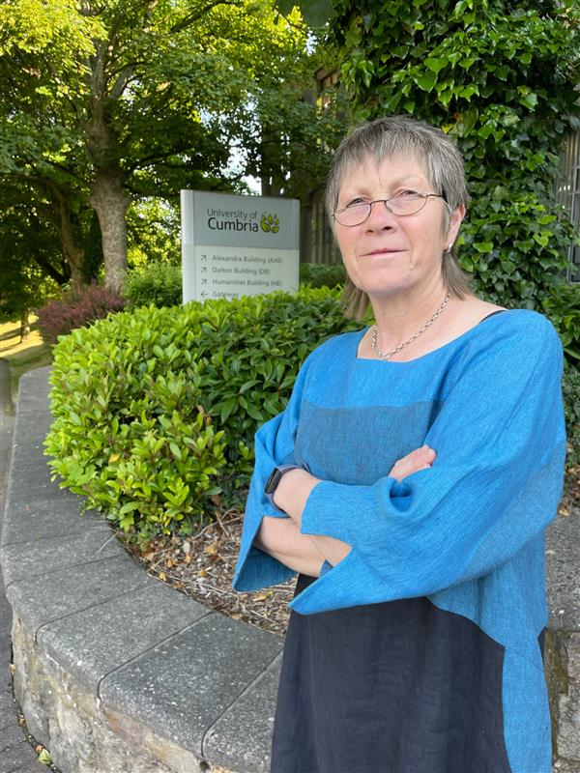
Dr Amanda Taylor-Beswick,
Professor of Digital and Social Science
Email: a.taylor-beswick@cumbria.ac.uk
Blog: https://amltaylor66.wordpress.com/about/
Bluesky: https://bsky.app/profile/amltaylor66.bsky.social
LinkedIn: https://www.linkedin.com/in/dr-amanda-m-l-taylor-beswick-b3810647/
Web-profile: https://www.cumbria.ac.uk/study/academic-staff/all-staff-members/senior-leadership-team/amanda-ml-taylor-beswick.php

Slide 3

This Photo by Unknown Author is licensed under CC BY-SA-NC

Slide 4
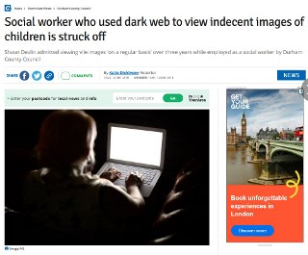
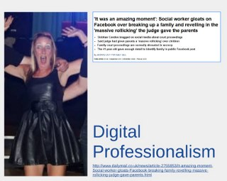

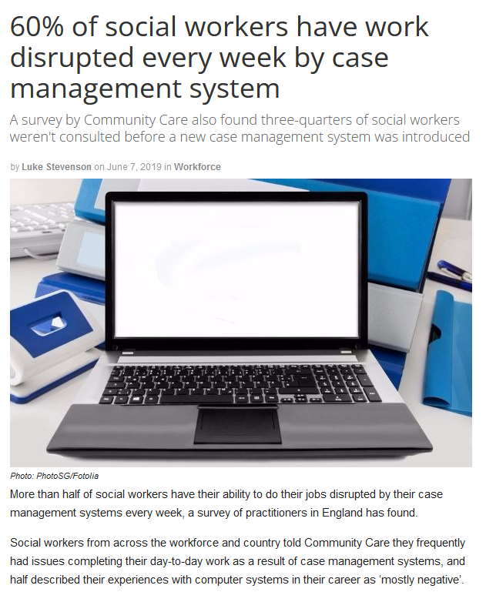
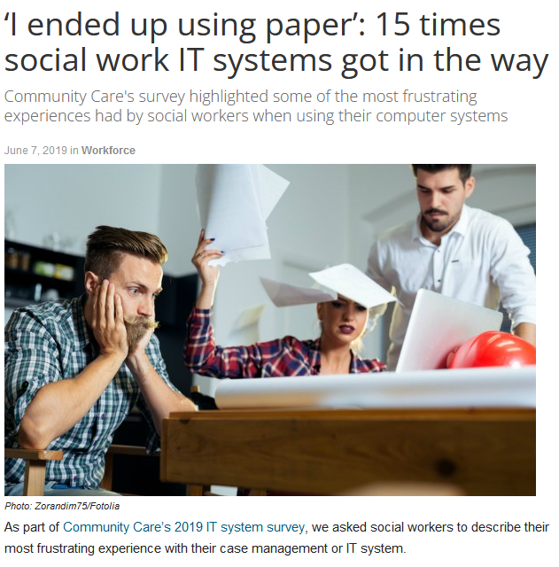
Social work and technologies: a long troubled and troubling relationship

Slide 5
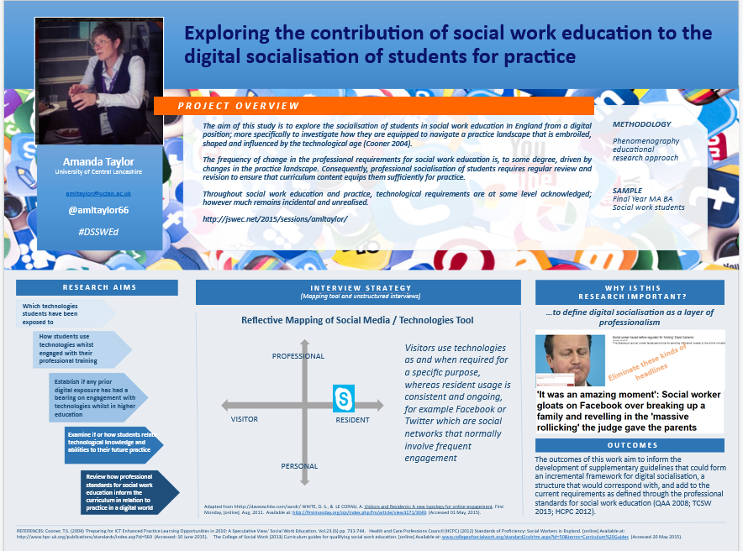
Examining the contribution of social work education to the digital professionalism of students for practice in a digital world

Slide 6
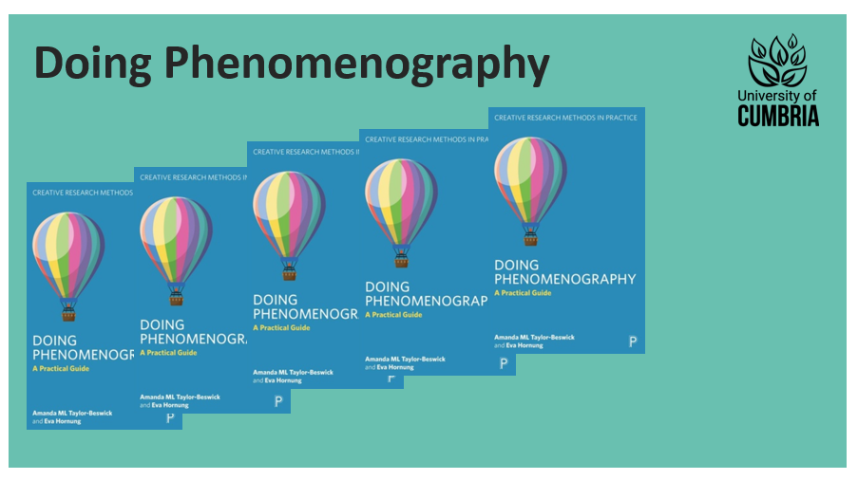

Slide 7
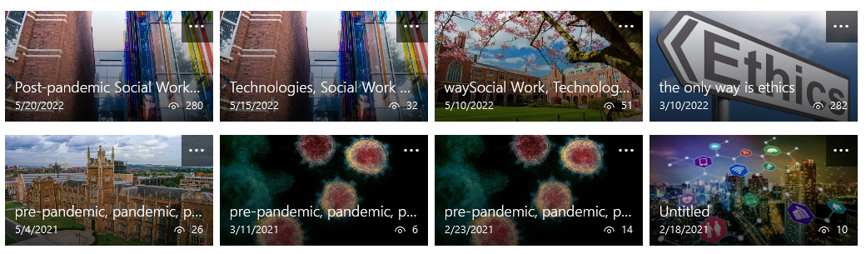
Pre-pandemic, Pandemic, Post-Pandemic Social Work Education

Slide 8

UoConnectED Digital Educator

Slide 9
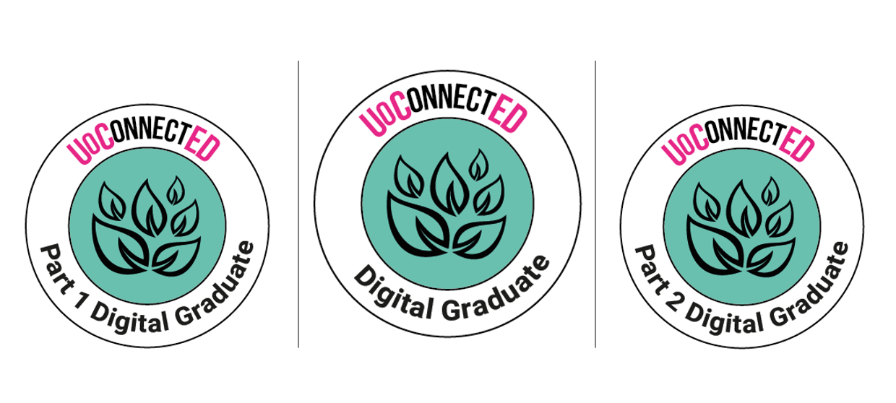
UoConnectED Digital Graduate

Slide 10

UoConnectED Professional Services

Slide 11

Returning to the why…
“The conference was designed to create a forum for academics, their students, developers and strategic managers to consider the opportunities, challenges and the disruptive influence of social media for learning.”

Slide 12
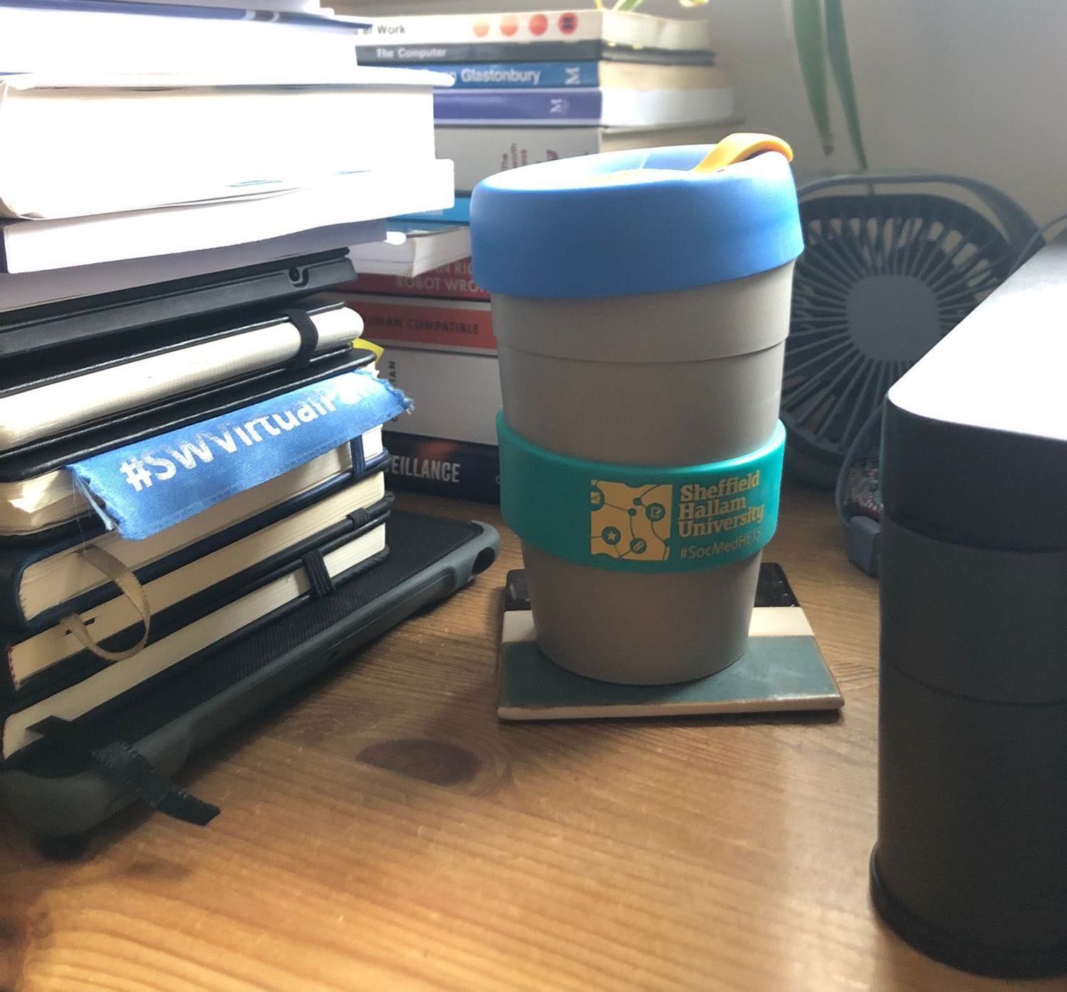
“SocMedHE is much more than just a conference…”
it is a dynamic, collaborative space that challenges
us to grapple with the evolving roles of digital tools
in and for teaching and learning, from social
media platforms to AI.
Turner and Honeychurch (2024)

Slide 13
SocMedHE15
2015: Finding Our Social Identity
Overview: The inaugural conference at Sheffield Hallam University aimed to create a forum for academics, their students, developers and strategic managers to consider the opportunities, challenges and the disruptive influence of social media for learning.
Key Themes:
  Learning communities: Practical demonstrations of tools and approaches being used to facilitate discussion and collaboration.
  Ethical and practical challenges: Balancing institutional control with the freedom of open networks.
  Early student-led initiatives: Student-driven social media groups evolving organically to support collaborative learning.
Highlight: The interplay between institutional strategy and student autonomy in using social media for educational purposes.

Slide 14
SocMedHE16
2016: The Empowered Learner
Overview: SocMedHE16 focused on the learner's autonomy and empowerment through social media, including how social media platforms could redefine higher education.
Key Themes:
  Digital identity: Helping students manage their presence in professional and personal online spheres.
  Autonomy in learning: Encouraging students to take control of their educational journeys through connected tools.
  Critical engagement: Questioning whether these tools genuinely empower learners or introduce new and different types of difficulties and dependencies.
Highlight: An emphasis on authentic learning experiences and the evolution of curriculum design.

Slide 15
SocMedHE17
2017: Making an Impact
Overview: Against the backdrop of metrics-driven educational pressures, this conference explored social media’s role in meeting these challenges.
Key Themes:
  Engaging diverse learners: Using social media to break traditional barriers in accessibility and inclusivity.
  Employability: Aligning social media use with skills valued in professional contexts.
  Scaling innovations: From small-scale trials to institution-wide practices.
Highlight: Practical examples of how pedagogic innovation using social media aligned with external metrics.

Slide 16
SocMedHE18
2018: Exploring Pedagogic Potential
Overview: This year emphasised innovative teaching practices and student engagement through technology.
Key Themes:
  Transformative practices: Educators shared case studies on how social media enhanced both teaching quality and learning outcomes.
  Cross-disciplinary strategies: Using social media tools to engage students in diverse academic fields.
Highlight: A move toward embedding digital literacy into the core of the curriculum.

Slide 17
SocMedHE19
2019: Digital Inclusion
Overview: With growing awareness of the digital divide, the conference explored how social media can bridge gaps in learning.
Key Themes:
  Accessibility: Ensuring that social media tools are usable by all, regardless of socio-economic or physical constraints.
  Collaboration: Developing partnerships between students and educators to create inclusive digital strategies.
  Policy discussions: Addressing concerns about data privacy and ethical usage.
Highlight: Strategies for equitable access to learning tools emerged as a key area of focus.

Slide 18
SocMedHE20
2020: Adapting to Change (Online)
Overview: The pandemic shifted the conference entirely online, focusing on social media’s role during a global crisis.
Key Themes:
  Remote learning: Leveraging social media to maintain engagement and interaction during lockdowns.
  Rapid adoption: Educators and students adapted to new tools in a compressed timeline.
  Community resilience: Using platforms to sustain a sense of connection and belonging.
Highlight: Emphasis on overcoming challenges in digital engagement during unprecedented times.

Slide 19
SocMedHE21
2021: Social Media as a Lifeline
Overview: Continuing the focus on post-pandemic recovery, the conference explored sustaining the momentum of digital adoption.
Key Themes:
  Hybrid learning models: Combining in-person and online strategies.
  Sustained engagement: Developing long-term strategies for using social media effectively.
  Mental health: Addressing the toll of digital fatigue and promoting positive online environments.
Highlight: Discussions about balancing technology use with the need for human connection in education.

Slide 20
SocMedHE22
2022: Expanding Horizons
Overview: With social media deeply integrated into learning, the focus shifted to innovative applications in education.
Key Themes:
  Global collaboration: Leveraging social platforms to connect learners worldwide.
  Creative pedagogy: Using tools like TikTok and Instagram for interactive teaching.
  Ethical considerations: Revisiting data privacy issues with newer platforms.
Highlight: Emphasis on preparing students for a globally connected professional world.

Slide 21
SocMedHE23
2023: Resilience and Innovation
Overview: This year emphasised resilience in educational practices and sustaining innovation.
Key Themes:
  Emerging platforms: Integrating new tools while revisiting older ones.
  Building resilience: Preparing educators and students to adapt to future challenges.
  Institutional support: Strengthening infrastructure for digital adoption.
Highlight: Collaborative workshops on future-proofing educational strategies using social media.

Slide 22
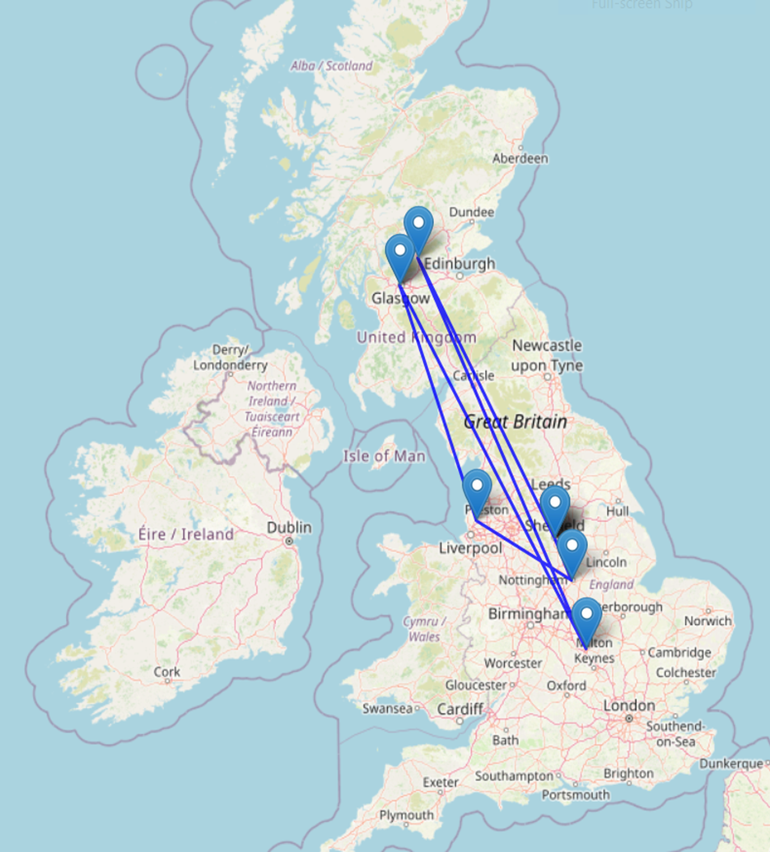

SocMedHE connectography
1st Sheffield Hallam University
2nd Sheffield Hallam University
3rd Sheffield Hallam University
4th Nottingham Trent University
5th Edge Hill University
6th Universities of Strathclyde and Glasgow
7th Universities of Strathclyde and Glasgow
8th University of Northampton
9th University of Stirling
10th Sheffield Hallam University
where connectivity meets geography you get connectography

Slide 23
SocMedHE24
2024: Reflecting on a Decade
Overview: The 2024 conference aims to revisit the origins and work done, alongside considering ways forward.
Phenomenographic lens on the collective experience of the SocMedHE as a social entity:
Initiating connection (#SocMEdHE15)
Maintaining communication (including #LTHEChat)
Sustaining collaboration

Slide 24
COVID19… more than a whole new vocab
Automated Attendance
Camera etiquette
Microphone etiquette
Chat function
Break(s)
Interactivity
You're on mute

Slide 25
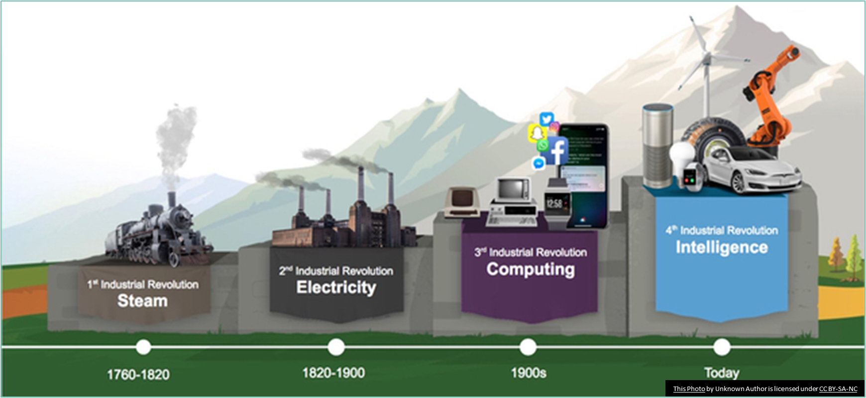
Rapidity of the Evolving Practice Landscape

Slide 26
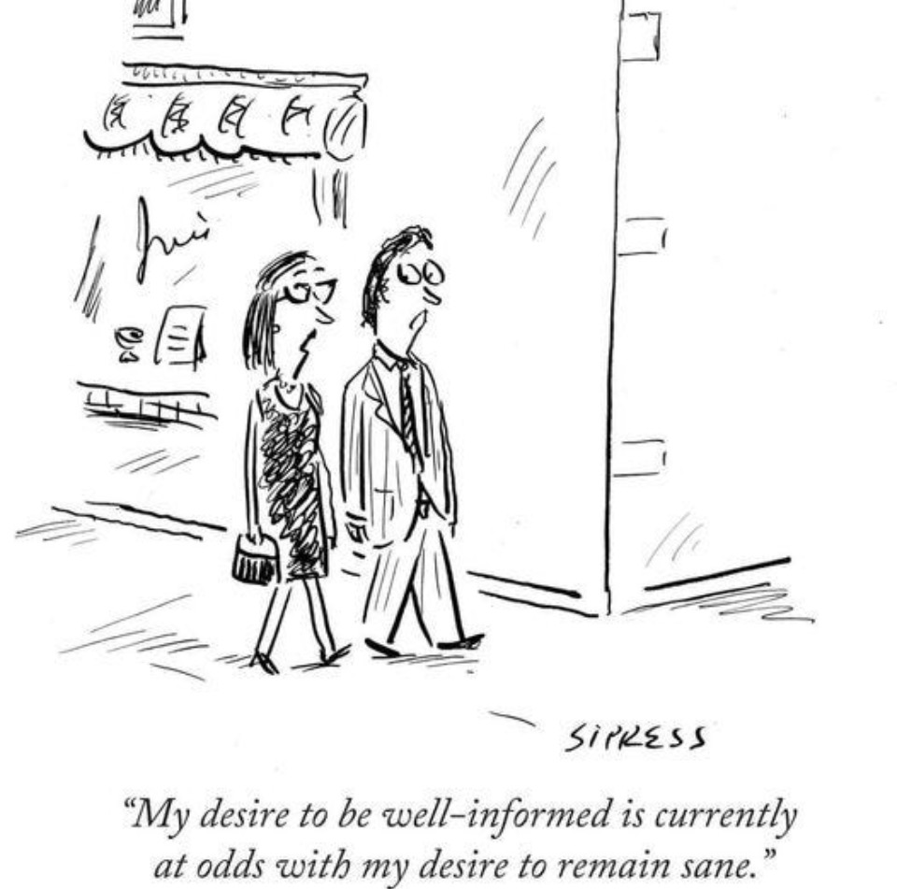
Resonate?

Slide 27

4IR
This Photo by Unknown Author is licensed under CC BY

Slide 28
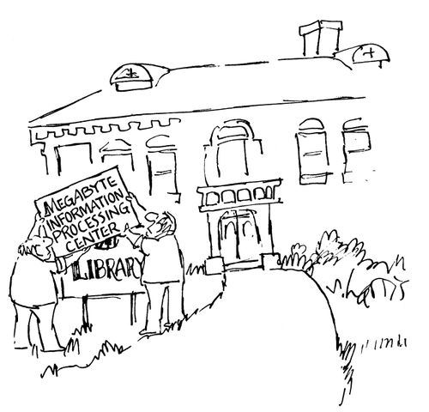
Post pandemic liminality
Persisting challenges to sociality, proximity, relationality, how we as a sector convene, engage, intervene.
Shifts that continue to demand much more radical changes to the nature and work of post-compulsory education providers.

Slide 29

“However, are these findings a question of a momentary disruption and a return to the previous status quo?
Or does the pandemic represent the kind of external shock that fundamentally changes the landscape?”
Broadbent, J., Ajjawi, R., Bearman, M. et al. Beyond emergency remote teaching: did the pandemic lead to lasting change in university courses?.
Int J Educ Technol High Educ 20, 58 (2023)

Slide 30
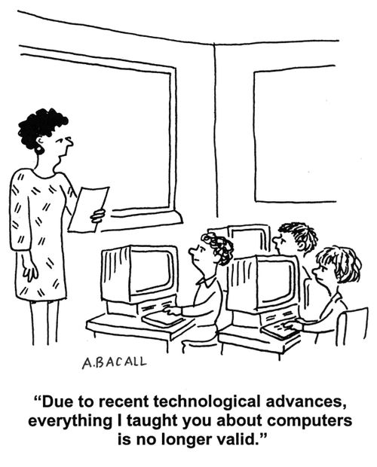
“Two contradictory visions for the role of educational technology in education after the pandemic seem possible: a pre- vs. post-digital view that imply fundamentally different perspectives for the future of education.
A pre-digital re-construction implies a return “back to normal”, whereas a post-digital view tries to utilize the experiences of the pandemic for a consequential reform of education.”
Kerres, M., Buchner, J. Education after the Pandemic: What We Have (Not) Learned about Learning. Educ. Sci. 2022, 12, 315

Slide 31
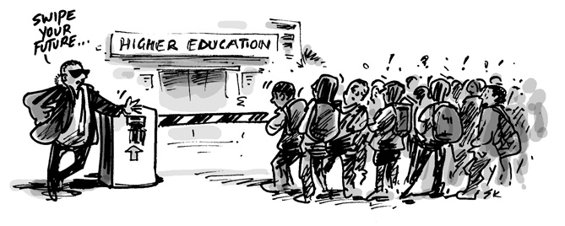
Fracturing of social spaces…
“HERE IS HOW platforms die: First, they are good to their users; then they abuse their users to make things better for their business customers; finally, they abuse those business customers to claw back all the value for themselves. Then, they die” Cory Doctorow (2023).

Slide 32
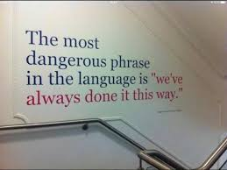
In comparison…
Physical structures are deeply rooted in cultural identity, built with durable materials, and adapted to changing needs tend to persist for centuries. In contrast, online spaces are ephemeral, relying on trends, user engagement, and technological infrastructure, making them far easier to "knock down" or abandon. The difference lies in their tangibility, symbolic importance, and societal investment.

Slide 33
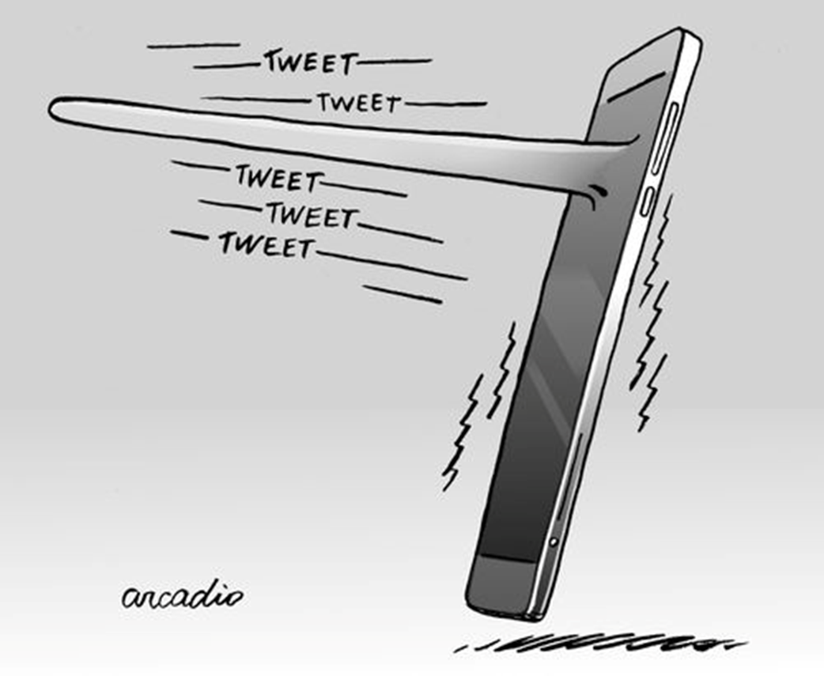
Xodus from X (formerly Twitter)
LTHE: a case study in managing community space transition seamlessly.
User Migration across Multiple Social Media Platforms Jeong, Nirmal, Jha, Tang, Bernard & Liu (2024)

Slide 34
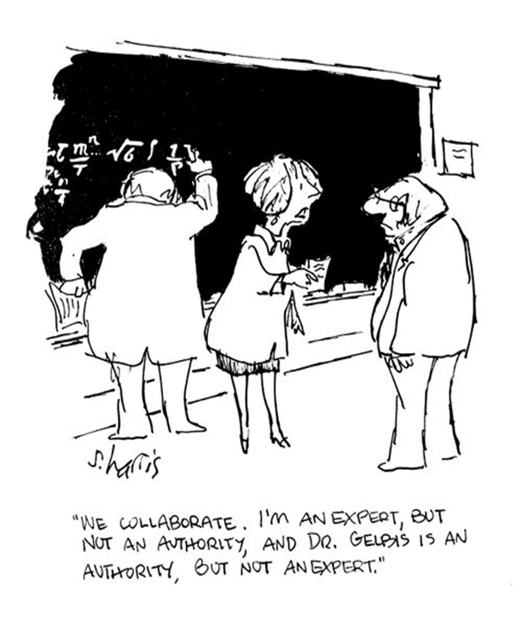
Fracturing of digital scholarship…
IF you’d asked me in 2009 what the future would be in academia
for a messaging/micro-blogging system limited to 140 characters,
I’d have said – zilch. Yet Twitter + blogs and many other social
media have transformed science and academic practice in the
interim. Mark Carrigan gives the first book-length and in-depth advice
on the many ways in which scientists and academics are developing
new paradigms of collective thought, writing and scholarly practice
using social media. If you’re still hesitating, get involved by starting
here.
Patrick Dunleavy
Professor of Political Science and Public Policy,
London School of Economics
https://soundcloud.com/eetheducationesearcher/academics-use-of-social-media-and-generative-ai-mark-carrigan

Slide 35
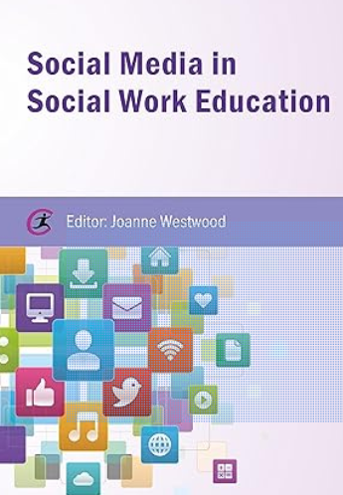
Using social media has been shown to be effective in reducing the isolation which students can experience when they first enter Higher Education. This isolation is not just experienced by first year undergraduates but also by PhD students as Thackray and Turner reflect on in their respective chapters. The potentials of social media to connect individuals and forge communities of learning is clear in the accounts of their involvement in debates, forums, and discussions about the progress they are making as well as in the works discussed by Singh Cooner and Taylor. The survey findings discussed in Westwood, Taylor, and McKendrick also demonstrate that connecting with peers and likeminded individuals would motivate social work students to continue to use social media tools in their studies to support more traditional learning strategies.

Slide 36
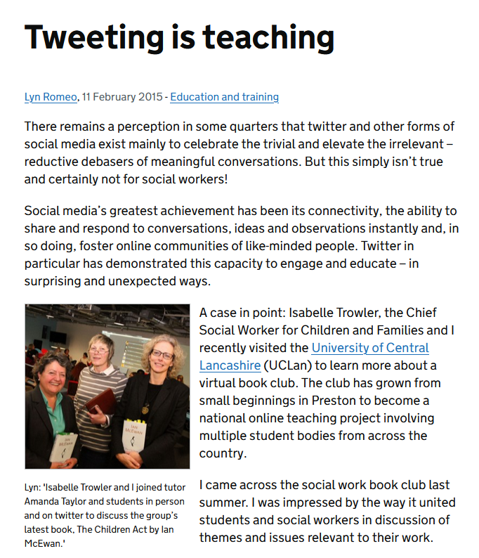
“Social media’s greatest achievement has been its connectivity, the ability to share and respond to conversations, ideas and observations instantly and, in so doing, foster online communities of like-minded people. Twitter in particular has demonstrated this capacity to engage and educate – in surprising and unexpected ways”
Lyn Romeo, Chief Social Worker, DHSC.

Slide 37
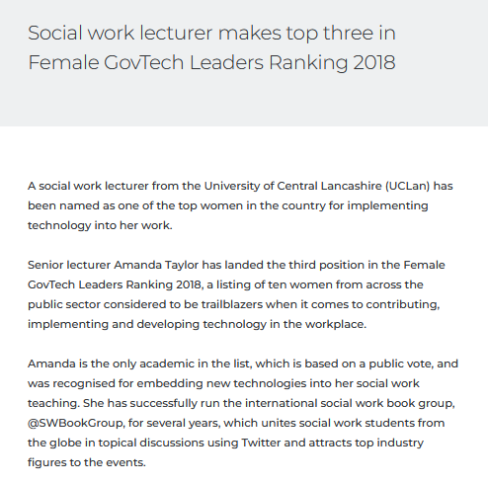
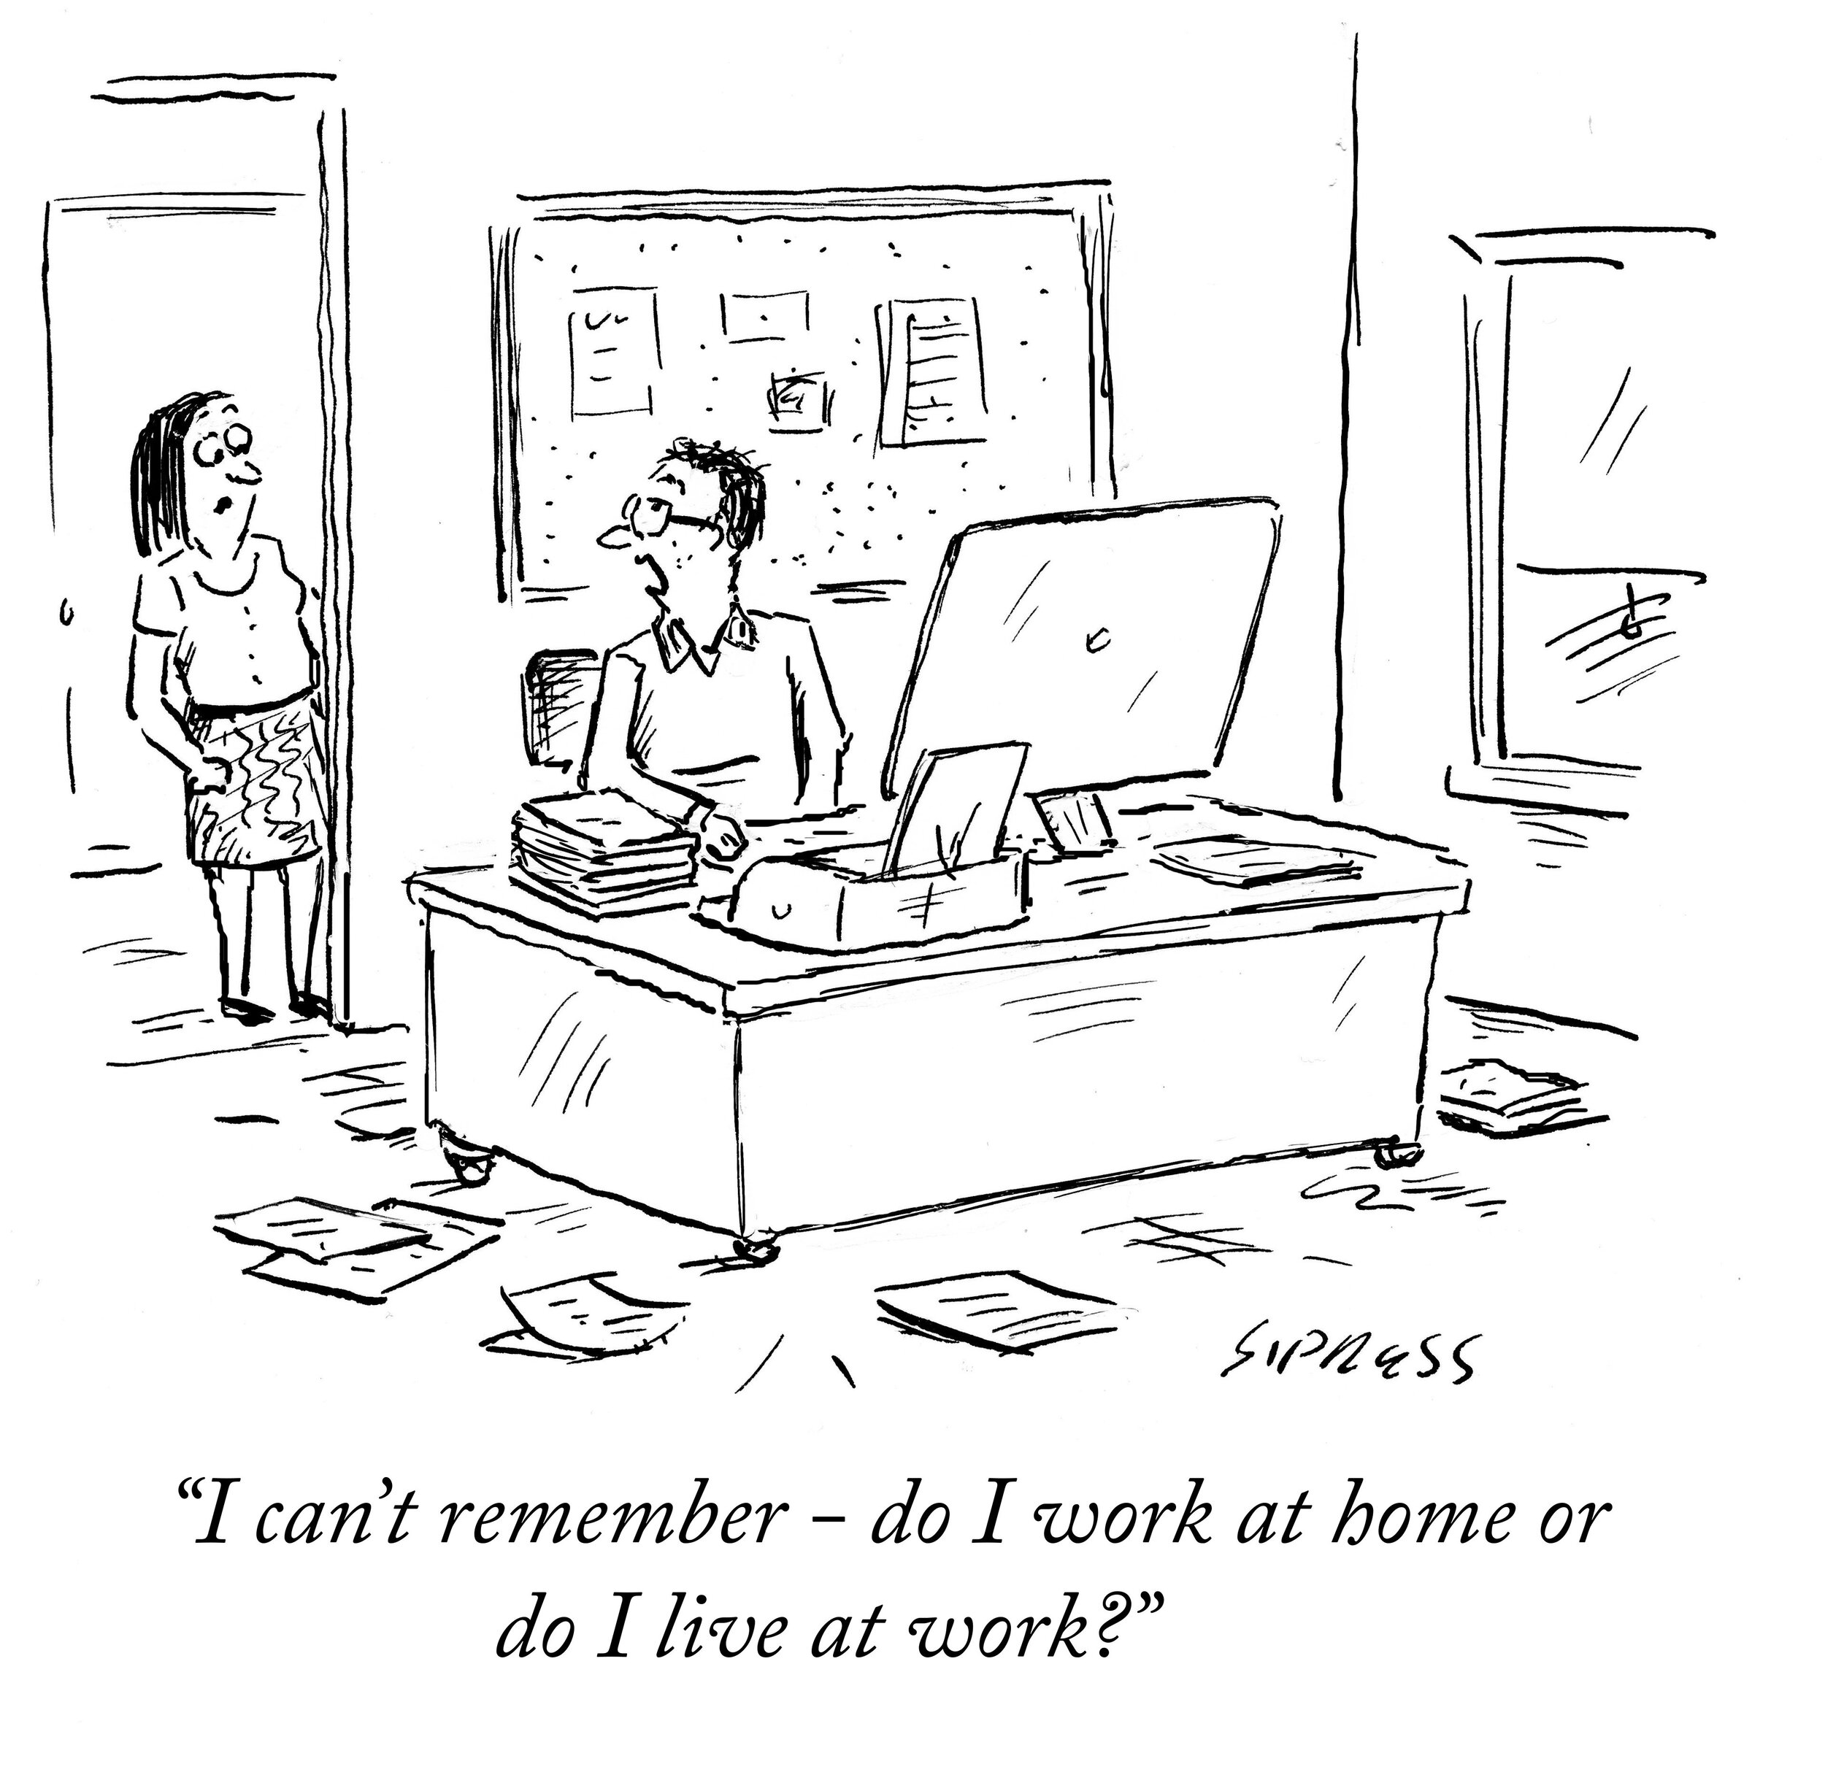

Slide 38
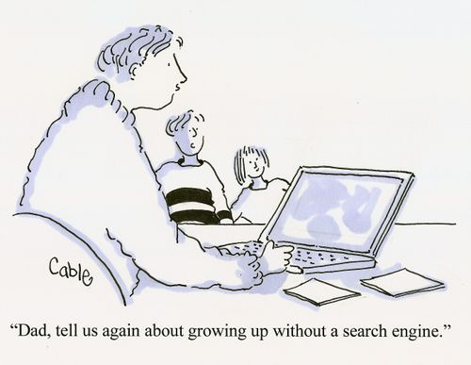
Postdigital

Slide 39
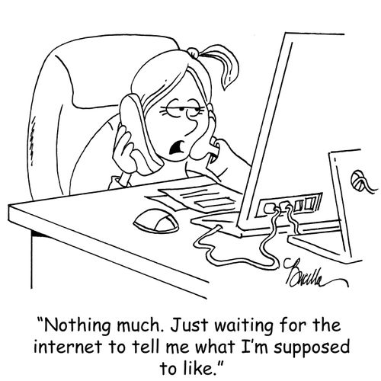
“Postdigital is a paradigm that (as with post-humanism) does not aim to describe a life after digital, but rather, attempts to describe the present-day opportunity to explore the consequences of the digital and of the computer age.”
Giorgio Agamben (2002).

Slide 40
“There is, therefore, an additional and valuable meaning we might attached the to the ‘post’ of the postdigital here: a ‘holding-to-account’ of the digital that seeks to look beyond the promises of instrumental efficiencies, not to call for their end, but rather to establish a critical understanding of the very real influence of these technologies as they increasingly pervade social life.”
Jandrić, P., Knox, J., Besley, T., Ryberg, T., Suoranta, J., & Hayes, S. (2018). Postdigital science and education. Educational philosophy and theory, 50(10), 893-899.

Slide 41
“Burbules argued that philosophers of education need to critically engage with the
profound implications of new information and communication technologies in
education. He highlighted the potential opportunities and dangers presented by
these technologies, such as the risk of creating an information caste society,
commercialization of education, and the deinstitutionalization of traditional schooling.
He emphasized the need for philosophical analysis and critique of ontological, epistemological, ethical, and identity issues raised by these technologies, as well as their impact on learning, pedagogy, and curriculum. He called for philosophers of education to play an active role in shaping the development and implementation of…technologies in ways that align with educational values and goals. His call is as relevant, or even more so today as it was in 2000”
Sidorkin, A. M. (2024).

Slide 42
Social media pedagogy (and infographic envy!)
“It is therefore vital that a critical review of their use is considered. It is incumbent upon journal editors to seek a critical approach from authors writing about social media in the context of learning and teaching.”
“In the process of carrying out this systematic review we have been able to understand the role of social media for learning and how it has changed over the last 10 years. We have noticed the increa2sing value of social media for learning communities, communication in those communities, and for building digital confidence”
Purvis, A., & Beckingham, S. (2024). A decade of social media for learning: A systematic review. Journal of University Teaching and Learning Practice, 21 (5).

Slide 43
Criticality and ethics…
“It is therefore inevitable that human behaviours evolve with the change in the available ways that we can interact and communicate with each other.
However, few of us question the ethics or the personal and societal consequences of change, and the views of those that do challenge the accepted norms appear to be extreme or alarmist. Institutions must take the responsibility as a community of staff and students to remain cautiously critical, not simply adopting evolving social behaviours as mainstream without critique.
We must promote critical awareness as part of the learning design process, and encourage holistic thinking, including sustainability, ethics, impacts, and personal boundaries…”
Purvis, Rodgers, Beckingham (2020).

Slide 44

Defining 2024 social medias’: adult decision-making on young peoples engagement.
(a) an electronic service that satisfies the following conditions:
(i) the sole purpose, or a significant purpose, of the service is to enable online social interaction between 2 or more end-users;
(ii) the service allows end-users to link to, or interact with, some or all of the other end-users;
(iii) the service allows end-users to post material on the service.
The Australian government has just announced that it will ban all young people under the age of 16 from using social media. Dr. Clare Southerton explains the background to this ‘ban’ and what it might mean for students and schools.
https://open.spotify.com/episode/1vBWX4KIrYA7aA79HKK5BH?si=225d7bb3b35a4282

Slide 45
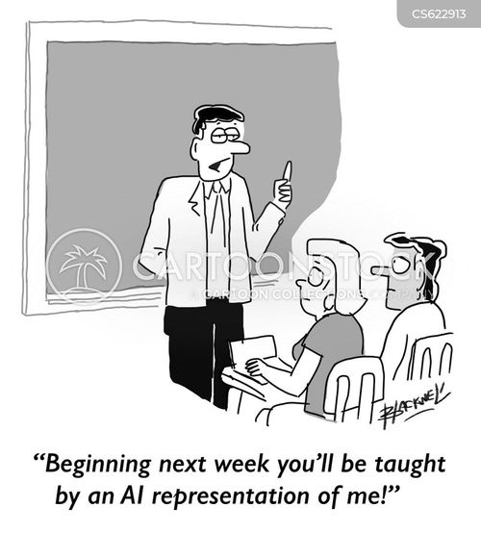
“With regard to the question of purpose, I have suggested that education actually has three purposes — or, more precisely, three domains of purpose — to attend to. I have referred to these as qualification, socialization, and subjectification.”
Biesta, G. (2024), Taking Education Seriously: The Ongoing Challenge. Educ Theory, 74: 434-448.

Slide 46
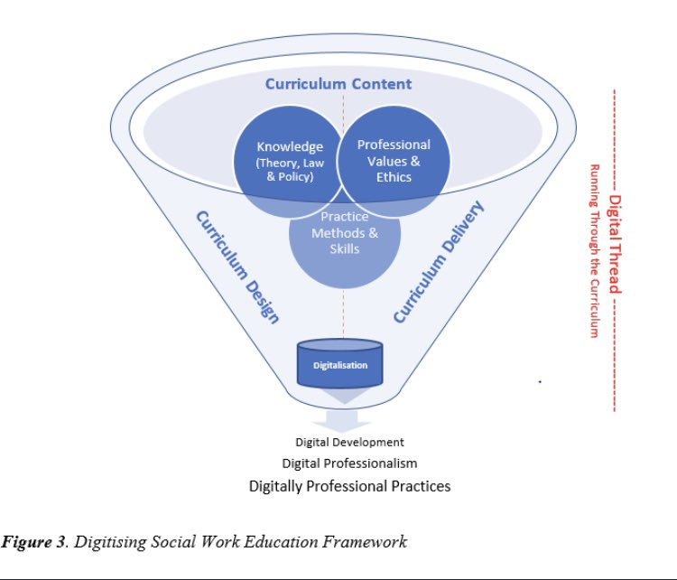
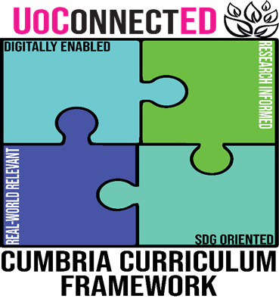

Slide 47
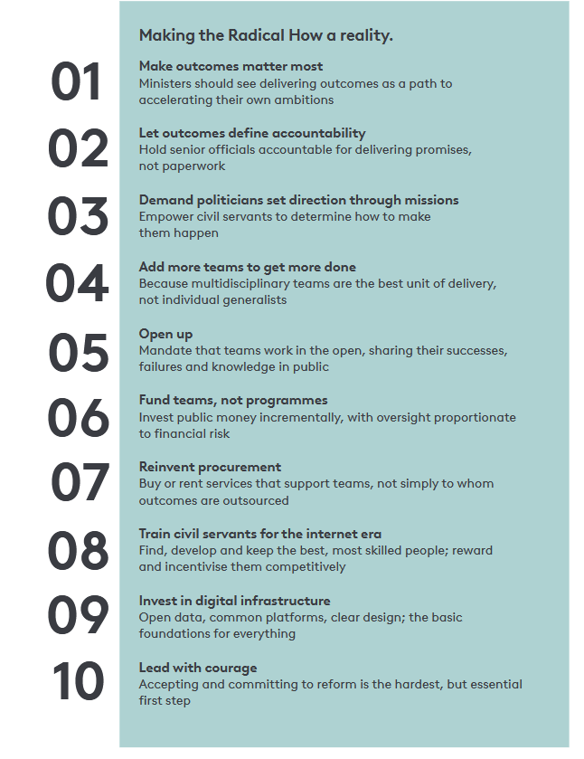
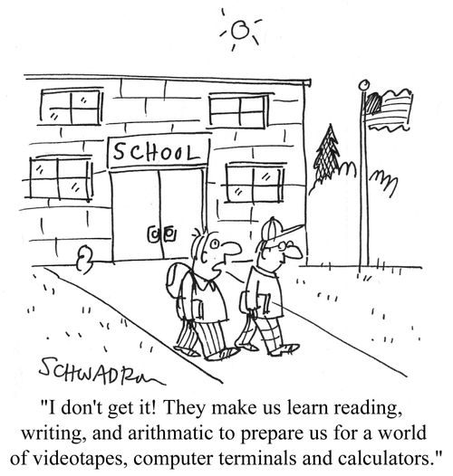
The Radical How…

Slide 48


SocMedHE future… what now for an even more radical how
This Photo by Unknown Author is licensed under CC BY-ND
https://www.menti.com/al5sytmtui4i

