Slide 1
Primary English 2023: Teaching in between constraints to challenge a pedagogy of adherence
Dr Adrian Copping
Adrian.copping@cumbria.ac.uk
Notes:
This piece of work has arisen out of something that has troubled me since I joined a primary school leaders facebook group and spend time in discussion with student teachers following school placements. What has troubled me is the shift from child-centred to curriculum centred pedagogy, the rise of schemes, how that impacts on my teaching and my students’ learning and enactment. There are some of my own reflections here as well as some evidence gathered from PGCE students.
But firstly a bit about me

Slide 2
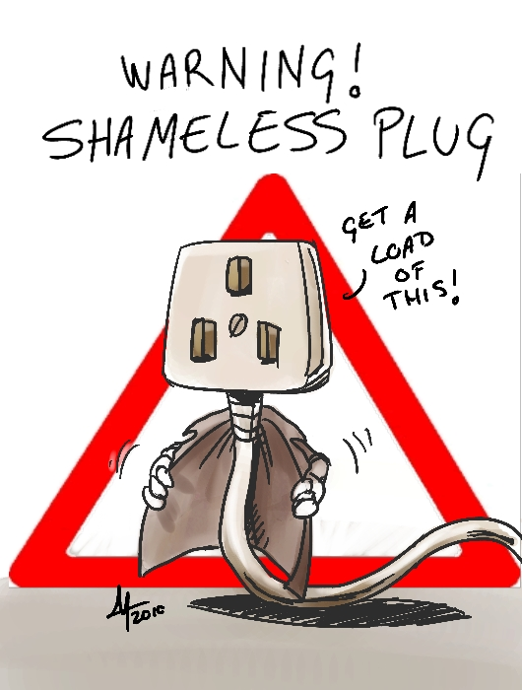
Who am I?
Primary PGCE Programme Leader
Primary English tutor
Primary English subject co-ordinator
Primary English author
Notes:
This is to provide some context, why I may have an interest in terms of improving student outcomes, but also subject quality
And also a shameless plug

Slide 3
60 PGCE Primary students (45 campus-based, 15 school direct) – range of ages, life stages, experience
Wide range of Lancashire & Cumbria schools
60% of course completed, 2x 6 week placements + 90% of taught input
Notes:
Reflection on student questions, on feedback from partnership staff and my own thinking
But also some evidence gathering – perception evidence

Slide 4
Happens
Centre-based session
School-based enactment

Slide 5
Three questions
From your primary English centre-based sessions, what do you think you have been able to enact in school?
For those areas you could enact, how was that enabled?
For those areas you couldn’t enact, what were the constraints?

Slide 6
SPAG (10)
Modelling (7)
Writing process (6)
Drama approaches (5)
From your primary English centre-based sessions, what do you think you have been able to enact in school?
From your primary English centre-based sessions, what do you think you have been able to enact in school?
Teaching sequence (5)
Interesting lessons (4)
Hosting a debate (4)
Review/model (3)
Summative assessment (3)
WAGOLLs (2)
Notes:
I was pleased and I admit to be a little surprised that in the range of answers to question 1 – what could be applied and enacted on placement, all aspects of the module and they key areas taught got a mention. But these are the top ten by frequency of response, and the numbers of responses. (26 different responses) – the other 16 were mentioned once or twice

Slide 7
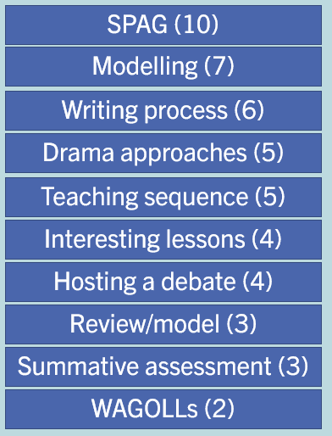
Does this reflect current priorities in school?
Surprise at Teaching sequence at no.5!
Guided work?
Given big focus on mentor texts, surprise WAGOLL is at no.10!
Interesting lessons at no.6, is teaching now a boring profession?
Notes:
I wonder if SPAG as the top answer reflects current priorities in school – impact of high-stakes testing and schemes?
Given the use of schemes in many of our schools, I was surprised to see enactment of planning a teaching sequence in at number 5, I would have expected it to be lower down
Guided reading and writing was mentioned once. Given the power for developing attainment in both reading and writing, I believe this has a pedagogic tool, I was disappointed that it didn’t make the top ten. Does it still exist or has it been replaced by the easier to manage hybrid whole class guided reading?
Has teaching become purely about delivering curriculum and therefore boring for teachers, children – impact on recruitment?

Slide 8
On a school direct programme where students perceived English input (from school subject leads) to be confusing – they declared to not have seen strategies or used them in enactment
Notes:
Now this is not a dig at SD programmes or school subject leads – it was significant in the data. Perhaps it raises the importance of HE pedagogy, further training for school colleagues involvement in ITE partnership? Or curriculum design, structure and information at point of need

Slide 9
From your primary English centre-based you have been able to enact in school?
enablers
uni sessions gave confidence
modelling
adapting a scheme
subject knowledge
SUPPORT
lesson format
directed reading
mentor direction
scaffolding process
adults in the room
set reading
mentor discussion
Notes:
Three areas of enablement – self, university input and school input – pleasing that there were some enablers to enactment

Slide 10
From your primary English centre-based you have been able to enact in school?
constraints
Resources
time
Fixed use of ‘talk for writing’
information overload
Assess only using ‘hot write’
School scheme
curriculum coverage
No curriculum choice
Fixed structure to English each week
Fixed way to teach guided writing
Mentor’s fixed beliefs about children’s capabilities
Need for a quiet classroom
Teacher control
children’s lack of imagination & confidence
confusing input led to lack of motivation to teach English
Notes:
Where curriculum approaches couldn’t be enacted, here were the constraints – or as I referred to on an earlier slide – the ‘something happens’ – a WORDLE type approach – bigger font = mentioned the most

Slide 11
A pedagogy of adherence
Fixed not flexible
A pedagogy of recipe not repertoire
Deliver curriculum not educate learners
Coverage is the enemy of understanding
MATs not HEIs
Teacher recruitment
Non-degree apprenticeships
Teacher retention
There is enabling of enactment, coaching, direction and discussion
Notes:
So here are some thoughts that came to my mind as I reflected on the responses

Slide 12
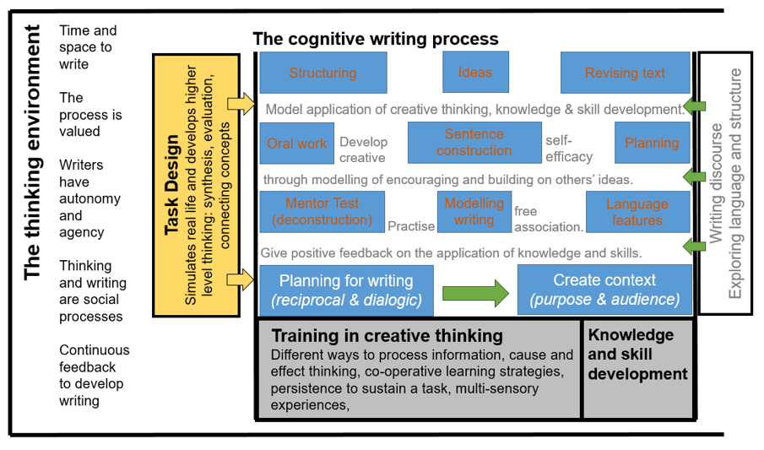
Notes:
Ask the audience – for their thoughts.
I think my Phd research might have something to offer here. The focus was creative thinking and children’s writing and I came up with a thinking for writing framework as a result – I have presented it at TEAN before. A huge key to enabling our students is to help them make connection between the schemes they may well come across and the excellent, evidence-informed high quality practice we as teacher educators provide. I call that working in the gaps. McWilliam would call it meddling in the middle.

Slide 13
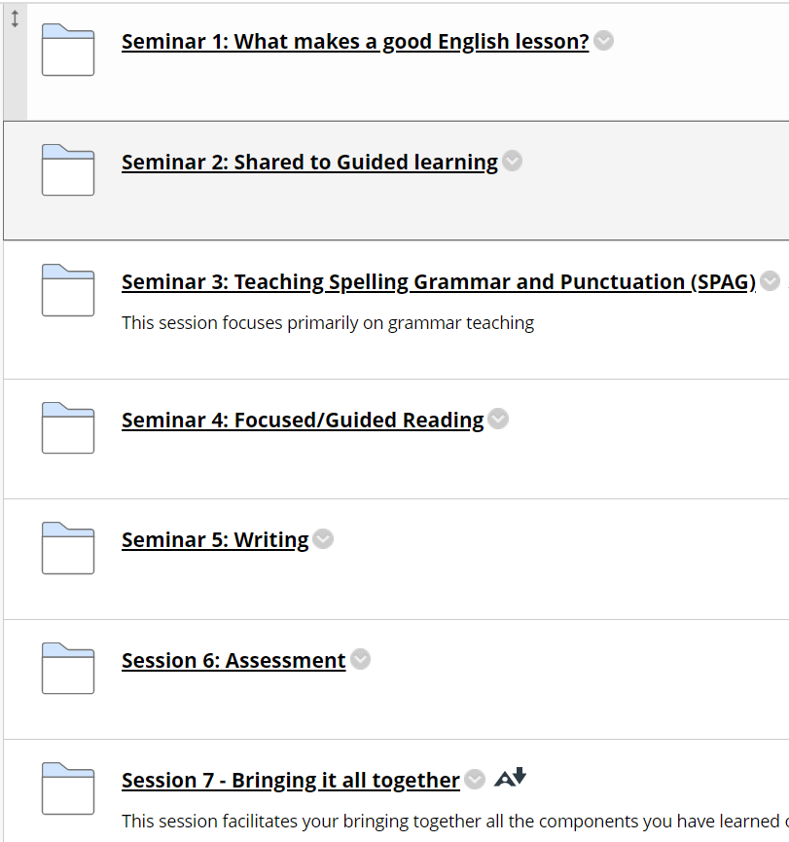
Developing confidence, decision-making, creative thinking skills.
Building cognitive connections between the building blocks through
real-life tasks;
Planning meetings
Scheme evaluation
Book scrutiny and assessing writing portfolios
Mini-teach opportunity
Maybe separating the components is also unhelpful??
Notes:
Here are the session headers for our primary PGCE English input. Many of them you will recognise – but do these provide students with skills, knowledge and underpinning understanding to enact in school. I think we need to be teaching in between the building blocks with tasks that simulate real life that develop higher level thinking, problem-solving and cognitive flexibility to navigate the fixedness, make evidence-based professional decisions responding to the needs of the learners.
So what might that look like? Click in

Slide 14
Next steps
English tutors observe students they have taught in school – discuss with students and subject leaders;
Meet with English team to discuss development of PGCE primary English approach – informed by this work and observations and discussions in school;
Evaluation and development 23/24.
Thank you
Adrian.copping@cumbria.ac.uk
Notes:
Evaluation and development in first two placements after the bulk of the university-based input

